Slide 1
Chapter 7
Reasoning Under Uncertainty & Fuzzy Logic
(From Probability to Fuzzy Thinking)

Slide 2
Roadmap
Need for Uncertainty
Probabilistic Reasoning
Bayesian Networks
Fuzzy Logic
AI Applications

Slide 3
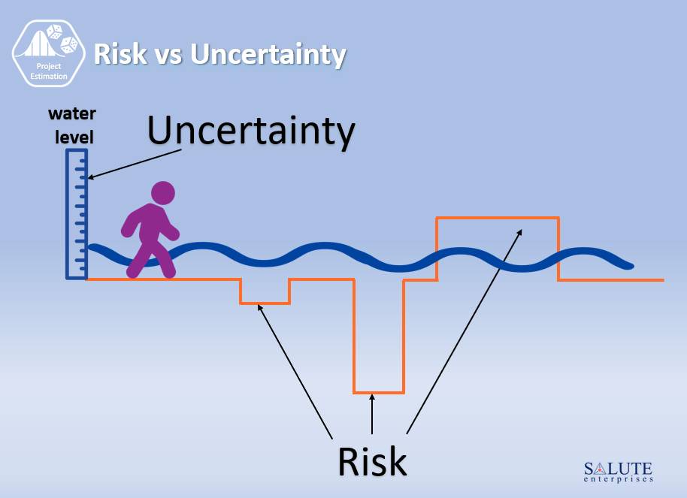

Slide 4
Why Does AI Need Uncertainty?
Real life is messy: incomplete, noisy, and vague (ambiguity terms)
AI systems often work in environments where complete information isn’t available or the data is noisy. In such cases, the AI must make decisions under uncertainty.
Examples: Diagnosing illness, weather forecasting, robot sensors
**Classical logic fails when info is incomplete
Yes or No → not enough!

Slide 5
Types of Uncertainty
Incomplete information
Noisy data
Ambiguity Terms

Slide 6
Uncertainty- Incomplete Information
Examples:
Medical Diagnosis: A patient’s medical record is missing key test results. The AI system must predict a diagnosis with only partial data — leading to uncertainty.
Self-Driving Cars:
A camera is temporarily blocked by fog, so the car can’t “see” a pedestrian clearly. The system has incomplete information about the environment.

Slide 7
Uncertainty-Noise Data
Examples:
Speech Recognition: Background noise in a crowded room makes it difficult for an AI to understand spoken words accurately.
Image Classification: Blurry or poorly lit photos confuse a model trained on clean images.
Sensor Data in IoT: A faulty temperature sensor gives fluctuating readings — the model becomes uncertain about the real temperature.

Slide 8
Uncertainty- Ambiguous Data
Meaning: The data itself can be interpreted in multiple valid ways, even if it’s complete and clean.
Examples:
Natural Language Processing (NLP): The sentence “I saw the man with the telescope.” Who has the telescope? The speaker or the man? The AI must choose one interpretation, introducing uncertainty.
Medical Imaging: A small dark spot on an X-ray could indicate several possible conditions (benign or malignant) — the data itself is ambiguous.

Slide 9
Uncertainty in AI
Approaches to manage uncertainty:
- Probability theory (Bayesian Theory: most
common)
Fuzzy logic
Bayesian Network
- Dempster-Shafer theory

Slide 10
Bayesian Theory in AI
Bayesian theory provides a probabilistic framework for updating beliefs based on new evidence.
Bayes’ Theorem: P(H|E) = (P(E|H) * P(H)) / P(E) Where: - H = hypothesis - E = evidence
- P(H|E) = probability of H given E (posterior)
- P(H) = prior belief about H
- P(E|H) = likelihood of E given H
- P(E) = overall probability of E
P(E) = P(E|H) X P(H) + P(E|~H) x P(~H)
In AI, it’s used for:
Updating predictions as new data arrives.
Inference in uncertain environments.
Learning from data probabilistically.

Slide 11
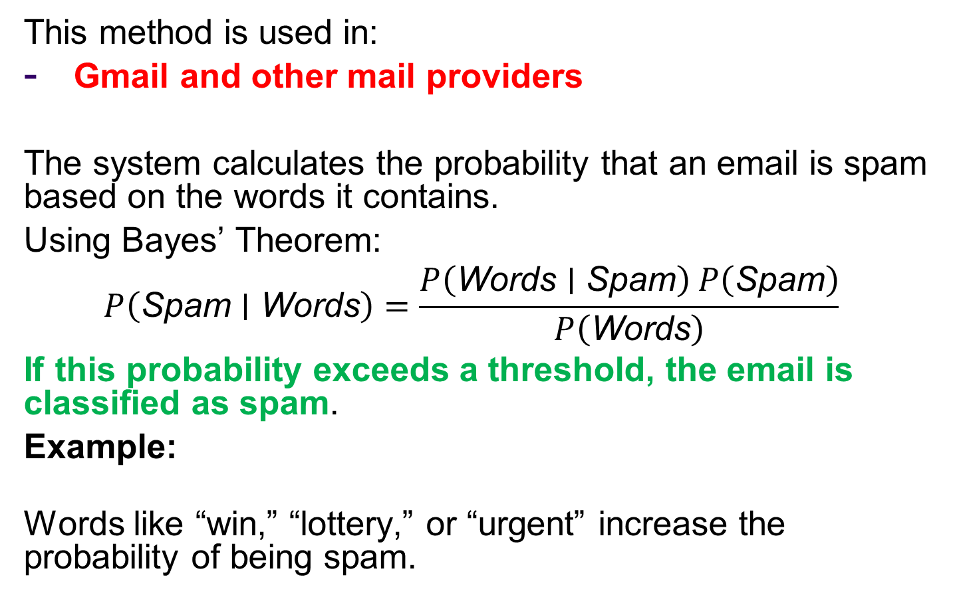
Bayesian Theory in AI (Some applications)
This method is used in:
Gmail and other mail providers
The system calculates the probability that an email is spam based on the words it contains.
Using Bayes’ Theorem:
$$P\left(\text{Spam}∣\text{Words}\right)=\frac{P\left(\text{Words}∣\text{Spam}\right) P\left(\text{Spam}\right)}{P\left(\text{Words}\right)}$$
If this probability exceeds a threshold, the email is classified as spam.
Example:
Words like “win,” “lottery,” or “urgent” increase the probability of being spam.

Slide 12
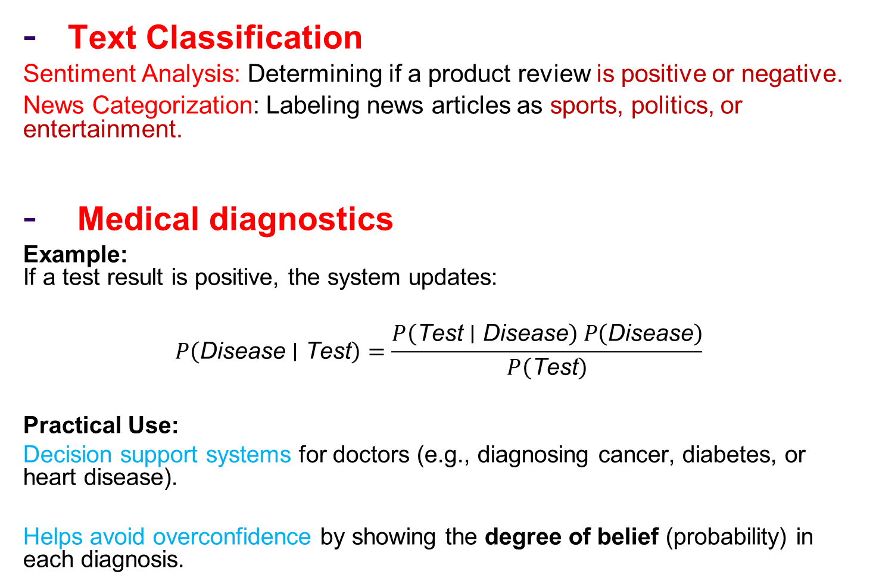
Bayesian Theory in AI (Some applications)
Text Classification
Sentiment Analysis: Determining if a product review is positive or negative.
News Categorization: Labeling news articles as sports, politics, or entertainment.
Medical diagnostics
Example: If a test result is positive, the system updates:
$$P\left(\text{Disease}∣\text{Test}\right)=\frac{P\left(\text{Test}∣\text{Disease}\right) P\left(\text{Disease}\right)}{P\left(\text{Test}\right)}$$
Practical Use:
Decision support systems for doctors (e.g., diagnosing cancer, diabetes, or heart disease).
Helps avoid overconfidence by showing the degree of belief (probability) in each diagnosis.

Slide 13
A very simple dataset – one field / one class
P34 level | Prostate cancer
High | Y
Medium | Y
Low | Y
Low | N
Low | N
Medium | N
High | Y
High | N
Low | N
Medium | Y

Slide 14
A very simple dataset – one field / one class
P34 level | Prostate cancer
High | Y
Medium | Y
Low | Y
Low | N
Low | N
Medium | N
High | Y
High | N
Low | N
Medium | Y
A new patient has
a blood test – his P34
level is HIGH.
what is our best guess
for prostate cancer?

Slide 15
A very simple dataset – one field / one class
P34 level | Prostate cancer
High | Y
Medium | Y
Low | Y
Low | N
Low | N
Medium | N
High | Y
High | N
Low | N
Medium | Y
It’s useful to know:
P(cancer = Y)

Slide 16
A very simple dataset – one field / one class
P34 level | Prostate cancer
High | Y
Medium | Y
Low | Y
Low | N
Low | N
Medium | N
High | Y
High | N
Low | N
Medium | Y
It’s useful to know:
P(cancer = Y)
- on basis of this tiny
dataset, P(c = Y)
is 5/10 = 0.5

Slide 17
A very simple dataset – one field / one class
P34 level | Prostate cancer
High | Y
Medium | Y
Low | Y
Low | N
Low | N
Medium | N
High | Y
High | N
Low | N
Medium | Y
It’s useful to know:
P(cancer = Y)
- on basis of this tiny
dataset, P(c = Y)
is 5/10 = 0.5
So, with no other info you’d expect P(cancer=Y) to be 0.5

Slide 18
A very simple dataset – one field / one class
P34 level | Prostate cancer
High | Y
Medium | Y
Low | Y
Low | N
Low | N
Medium | N
High | Y
High | N
Low | N
Medium | Y
But we know that P34 =H,
so actually we want:
P(cancer=Y | P34 = H)
- the prob that cancer is Y,
given that P34 is high

Slide 19
A very simple dataset – one field / one class
P(cancer=Y | P34 = H)
- the prob that cancer is Y,
given that P34 is high
- this seems to be
2/3 = ~ 0.67
P34 level | Prostate cancer
High | Y
Medium | Y
Low | Y
Low | N
Low | N
Medium | N
High | Y
High | N
Low | N
Medium | Y

Slide 20
A very simple dataset – one field / one class
So we have:
P ( c=Y | P34 = H) = 0.67
P ( c =N | P34 = H) = 0.33
The class value with the
highest probability is our
best guess
P34 level | Prostate cancer
High | Y
Medium | Y
Low | Y
Low | N
Low | N
Medium | N
High | Y
High | N
Low | N
Medium | Y

Slide 21
In general we may have any number of class values
suppose again we know that
P34 is High;
here we have:
P ( c=Y | P34 = H) = 0.5
P ( c=N | P34 = H) = 0.25
P(c = Maybe | H) = 0.25
... and again, Y is the winner
P34 level | Prostate cancer
High | Y
Medium | Y
Low | Y
Low | N
Low | N
Medium | N
High | Y
High | N
High | Maybe
Medium | Y

Slide 22
Bayesian Computation
Assume I have the following Table
Find the P(tonsillitis | headache) using Bayesian theorem
P(tonsillitis) = 0.7 P(~tonsillitis) = 0.3
P(headache| tonsillitis) = 4/7 =0.57
P(headache | ~ tonsillitis) = 2/3 = 0.667
Headache | tonsillitis
T | Y
T | N
F | Y
T | Y
F | Y
F | N
T | Y
T | N
F | Y
T | Y

Slide 23
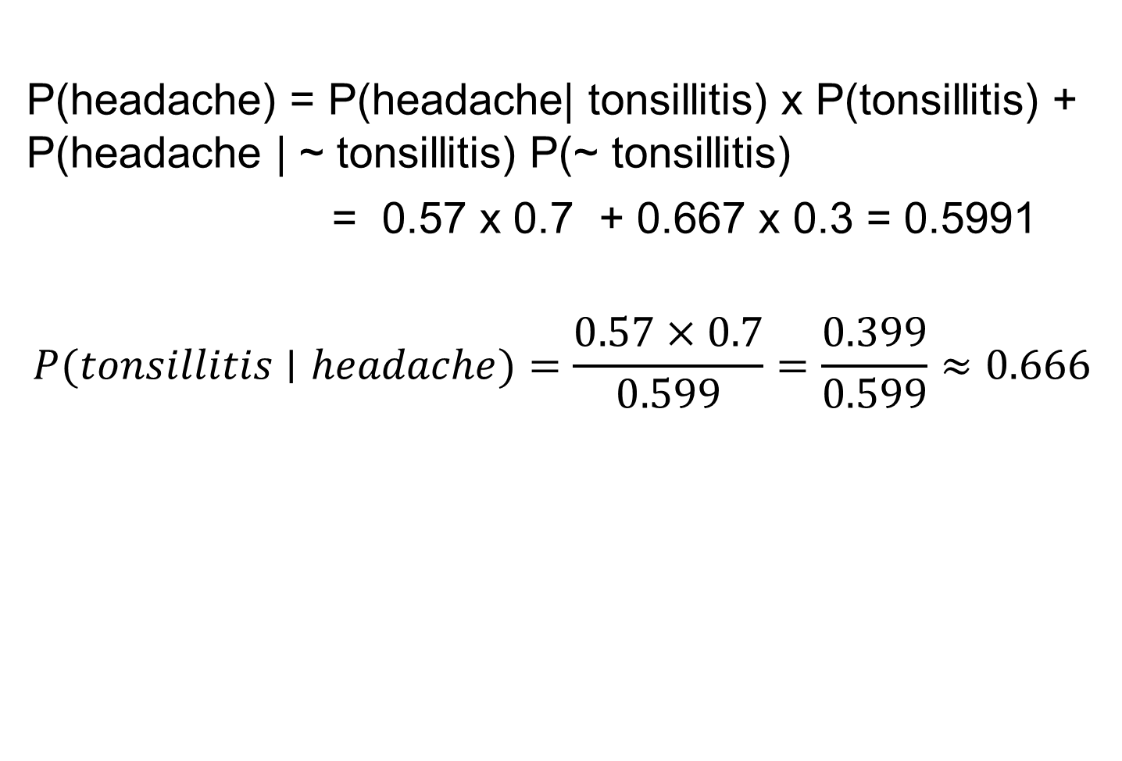
Bayesian Computation
P(headache) = P(headache| tonsillitis) x P(tonsillitis) + P(headache | ~ tonsillitis) P(~ tonsillitis)
= 0.57 x 0.7 + 0.667 x 0.3 = 0.5991
$$P(tonsillitis∣headache)=\frac{0.57×0.7}{0.599}=\frac{0.399}{0.599}≈0.666$$

Slide 24
Bayesian Theorem Example
We want to know: "Given a person tests positive for a disease, what is the probability they actually have it?“
Step 1: Define Events
D: Person has the disease
¬D: Person does not have the disease
T: Test result is positive
Step 2: Given Probabilities
Assume the following:
P(D) = 1% = 0.01 → Prior probability of having the disease
P(¬D) = 99% = 0.99 (1-P(D))
P(T|D) = 99% = 0.99 → Test correctly detects disease (True Positive)
- P(T|¬D) = 5% = 0.05 → False positive rate
We want to compute: P(D|T) → Probability person has the disease given they tested positive.

Slide 25
Bayesian Theorem Example
Step 3: Use Bayes' TheoremBayes' formula:
P(D|T) = [P(T|D) * P(D)] / P(T)
But we first need P(T) (total probability of testing positive):
P(T) = P(T|D) * P(D) + P(T|¬D) * P(¬D)
= (0.99 * 0.01) + (0.05 * 0.99) = 0.0099 + 0.0495 = 0.0594
Step 4: Plug into Bayes' Formula
P(D|T) = (0.99 * 0.01) / 0.0594 = 0.0099 / 0.0594 ≈ 0.1667 or 16.67%
Even though the test is 99% accurate, a person who tests positive only has a 16.67% chance of actually having the disease — because the disease is rare, and false positives affect the result heavily.

Slide 26
Bayesian Theorem Example (Python code)
#Step 1: Define probabilities
P_D = 0.01 # Probability of disease
P_not_D = 1 – P_D # Probability of no disease
P_T_given_D = 0.99 # True positive rate
P_T_given_not_D= 0.05 # False positive rate
#Step 2: Compute total probability of a positive test
P_T = (P_T_given_D * P_D) + (P_T_given_not_D * P_not_D)
#Step 3: Apply Bayes' Theorem
P_D_given_T = (P_T_given_D * P_D) / P_T
#Step 4: Display the result
print(f"Probability of having the disease given a positive test: {P_D_given_T:.4f} or {P_D_given_T*100:.2f}%")
Output: Probability of having the disease given a positive test: 0.1667 or 16.67%

Slide 27
Bayesian Theorem Example-2
We want to compute:
P(Spam | Email contains word "Free") → i.e., What's the probability an email is spam if it contains the word "Free"?
Assume from past data:
- P(Spam) = 0.2 → 20% of emails are spam
- P(Ham) = 0.8 → 80% are not spam
- P("Free" | Spam) = 0.6 → 60% of spam emails contain "Free"
- P("Free" | Ham) = 0.1 → 10% of normal emails contain "Free“
We want: P(Spam | "Free") (using Bayes' Theorem)

Slide 28
Bayesian Theorem Example-2
Bayesian formula
P(Spam | “Free”) = [P(“Free” | Spam) × P(Spam)] / P(“Free”)
We need to compute P(“Free”):
P(“Free”) = P(“Free” | Spam) × P(Spam) + P(“Free” | Ham) × P(Ham)
= (0.6 × 0.2) + (0.1 × 0.8) = 0.12 + 0.08 = 0.20
P(Spam | “Free”) = (0.6 × 0.2) / 0.20 = 0.12 / 0.20 = 0.60
P(Spam | “Free”) = 0.60 → 60%
So, if an email contains the word “Free”, there is a 60% chance it's spam.

Slide 29
Bayesian Theorem Example-2: Python code
P_spam = 0.2
P_ham = 0.8
P_free_given_spam = 0.6
P_free_given_ham = 0.1
#Total probability of "Free" appearing
P_free = (P_free_given_spam * P_spam) + (P_free_given_ham * P_ham)
#Bayes' Theorem
P_spam_given_free = (P_free_given_spam * P_spam) / P_free
print(f"Probability the email is spam if it contains 'Free': {P_spam_given_free:.2f}")
Print out:
Probability the email is spam if it contains 'Free': 0.60
So, if an email contains the word “Free”, there’s a 60% chance it’s spam.

Slide 30
Fuzzy Logic
Fuzzy Logic is a superset of conventional (boolean) logic that has been extended to handle the concept of partial truth. Truth values between “completely true” and completely false”, it was introduced by Dr. Lotfi Zadeh of UC/Berekely in 1960s as means to model the uncertainty of natural language.
Fuzzy Subsets
In classical set theory, a subset U of a set S can be defined as a mapping from the elements of s to the elements of the set {0,1}
U : S → {0,1}

Slide 31
Fuzzy Logic
This defines a mapping between elements of the set S and values in the interval [0,1]. The value zero is used to represent complete non-membership, the value one is used to represent complete membership, and the values in between are used to represent intermediate degrees of membership. The set S is referred to as the UNIVERSE OF DISCOURSE for the fuzzy subset U. Frequently, the mapping is described as a function, the membership function of F. The degree to which the statement
X is in F
Is true is determined by finding the ordered pair whose first element is X. The degree of truth of the statement is the second element of the ordered pair (X, degree(F)).
In practice, the terms “membership function” and fuzzy subset get used interchangeably.

Slide 32
Fuzzy Logic
Example
Let us talk about people and tallness. In this case the set S (the universe of discourse) is the set of people. Let’s define a fuzzy subset TALL (U), which will answer the question “to what degree is person X tall”
Zadeh describes TALL as a linguistic variable, which represents our cognitive category of tallness. To each person in the universe of discourse, we have to assign a degree of membership in the fuzzy subset TALL. The easiest way to do this is with a membership function based on the person ‘s height.

Slide 33
Fuzzy Logic
Person | Height | Degree of tallness | Crisp
Billy | 3’ 2” | 0.00 | 0
Yoke | 5’ 5” | 0.21 | 0
Drew | 5’ 9” | 0.38 | 0
Erik | 5’ 10” | 0.42 | 0
Jess | 7’ 2” | 1.00 | 1

Slide 34
Fuzzy Logic
Example
One could want to have the membership function for TALL depend on both a person ‘ s height and their age (He ‘s tall for his age). It ‘s referred to as two-dimensional membership function, or a “fuzzy relation”. To understand such kind of situations, we have to study the fuzzy logic operations.
Logic Operations
The standard definition in fuzzy logic are:
Truth (not x) = 1-truth(x)
Truth(x and y) = min(truth(x),truth(y))
Truth(x or y) = max (truth(x), truth(y))
For the previous example, we assume the same definition of TALL as above and in addition, assume that we have a fuzzy subset OLD defined by the membership functions

Slide 35
Fuzzy Logic

Slide 36
Fuzzy Logic

Slide 37
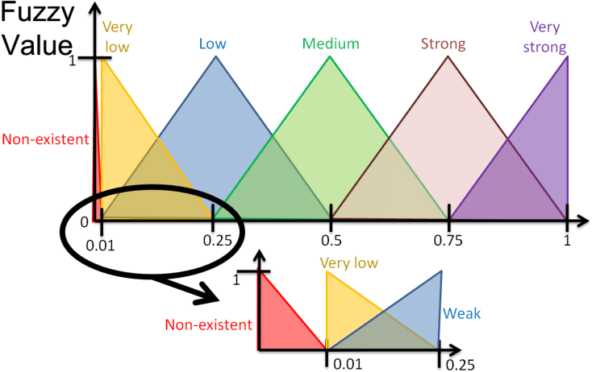

Slide 38
Fuzzy Logic
Rules in Fuzzy Logic
Given the following rule. The values of X in A3 and Y in B1 are assumed to be obtained through given membership functions. We need to find the value of Z with relation to C1.
Rule 1
If X is A3 (0.0) OR Y is B1 (0.1) Then Z IS C1 (0.1)
The value of Z can be obtained by one of two methods
Max [0.0,0.1] = 0.1
0.0 + 0.1 – 0.0 x 0.1 = 0.1
The two methods might not produce the same result, but we have to stick to only one method during the system 's inference.
Below is Rule 2 which uses AND logic relation instead of OR.
Rule 2
If X is A2 (0.2) AND Y is B2 (0.7) Then Z is C3 (0.2)
The value of Z can be obtained by one of two methods. They may not produce the same result.
Min [0.2,0.7] = 0.2
0.2 x 0.7 = 0.14

Slide 39
Fuzzy Logic

Slide 40
Fuzzy Logic

